Slide 1
Decision Tree

Slide 2
Decision Tree
Decision tree is a supervised type machine learning algorithm and it builds classification or regression models.
A Decision Tree is a Flow Chart, and can help you make decisions based on previous experience.
The two main entities of a tree are decision nodes, where the data is split and leaves, where we got outcome.
In a Decision tree, there are two nodes, which are the Decision Node and Leaf Node

Slide 3


Slide 4
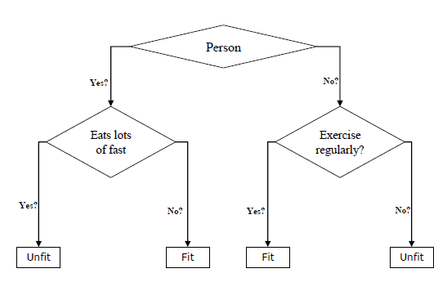
The example of a binary tree for predicting whether a person is fit or unfit providing various information like age, eating habits and exercise habits, is given below −

Slide 5
Classification decision trees − In this kind of decision trees, the decision variable is categorical. The above decision tree is an example of classification decision tree.
Regression decision trees − In this kind of decision trees, the decision variable is continuous.

Slide 6
Why Use Decision tree?
Decision Trees usually mimic human thinking ability while making a decision, so it is easy to understand.
The logic behind the decision tree can be easily understood because it shows a tree-like structure.

Slide 7
There are two methods create decision tree algorithm:
ID3 (Iterative Dichotomizer 3)
Gini Index

Slide 8
ID3 :
Find the Information gain of the target attribute.
Find the Entropy of rest attributes.
Find gain for each and every rest attribute.
Gain = IG - Entropy
The attribute that has highest gain will be selected as root node.

Slide 9
Information Gain: Information gain is used for determining the best features/attributes that render maximum information about a class.
Information Gain= Entropy(S)- [(Weighted Avg) *Entropy(each feature)
Entropy: Entropy is a metric to measure the impurity in a given attribute. It specifies randomness in data. Ut is basically ranges between 0-1.
Entropy can be calculated as:
Entropy(s)= -P(yes)log2 P(yes)- P(no) log2 P(no)
Where,
S= Total number of samples
P(yes)= probability of yes
P(no)= probability of no

Slide 10
Gini index:
It measures the impurities of nodes.
It varies between 0 to 1.
An attribute with the low Gini index should be preferred as compared to the high Gini index.
Gini index can be calculated using the below formula:
Gini index= 1 - Gini
Gini Index= 1- ∑_{j}P_{j}²
It works with categorical targets only.
An attribute with least gini index is preferred as root node while making decision tree

Slide 11
To make decision tree using Gini Index:
Gini index is calculated for all rest attributes.
Feature having less gini index values is selected for root node.

Slide 12
Decision tree consist of:
Nodes : Test for the value of a certain attribute.
Edges/ Branch :correspond to the outcome of a test and connected to the next node or leaf.
Leaf nodes : Terminal nodes that predicts the outcome.

Slide 13
Pruning in Decision tree:
Pruning is one of the techniques that is used to overcome problem of overfitting in decision tree.
A too-large tree increases the risk of overfitting, and a small tree may not capture all the important features of the dataset. Therefore, a technique that decreases the size of the learning tree without reducing accuracy is known as Pruning. There are mainly two types of tree pruning technology used:
Pre Pruning
Post Pruning

